Slide 1



IMDB DATASET
SQL REINFORCEMENT PROJECT
AKILAN J
DADS - Oct 24
06-01-2025

Slide 2
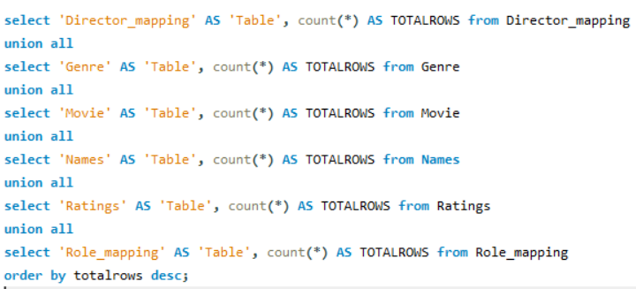
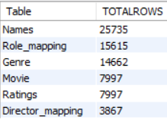
`
Find the total number of rows in each table of the schema.
Syntax
Output

Slide 3
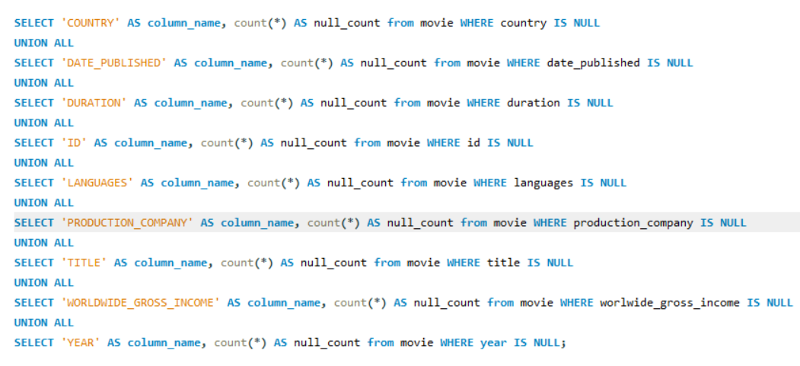
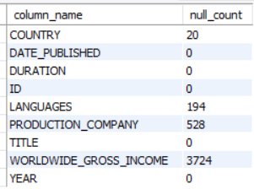
Which columns in the movie table have null values?
Syntax
Output

Slide 4

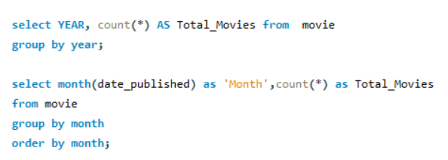
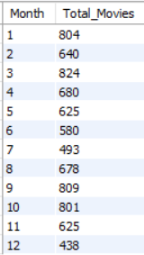
Find the total number of movies released each year.
How does the trend look month-wise?
Syntax
Output
Top Month
MAR
SEPT
JAN
Less Movie Counts
DEC
JUL
JUN

Slide 5
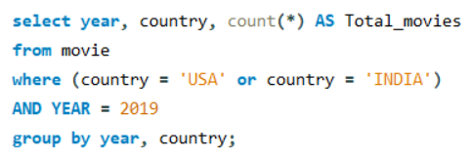

How many movies were produced in the USA or India in the year 2019?
Syntax
Output

Slide 6


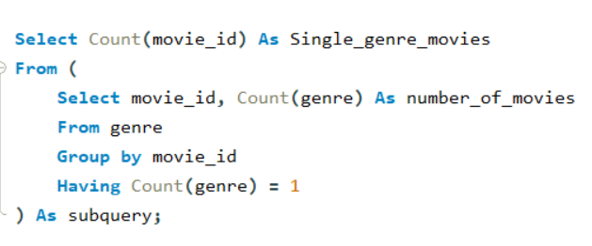

Find the unique list of genres present in the dataset and
how many movies belong to only one genre.
Syntax
Output
13 Genre

Slide 7
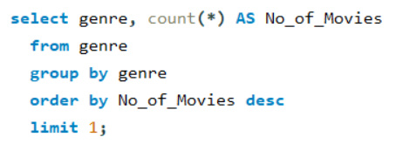

Which genre had the highest number of movies produced overall
Syntax
Output

Slide 8
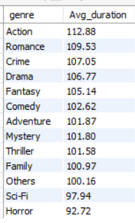
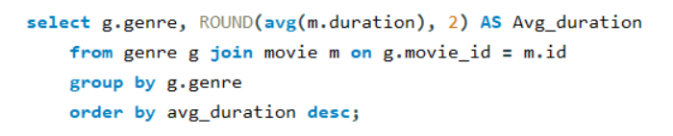
What is the average duration of movies in each genre
Syntax
Output

Slide 9
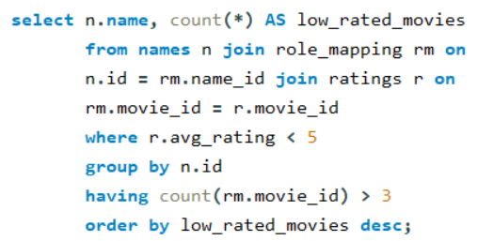
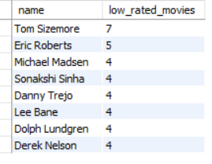
Identify actors or actresses who have worked in more than three movies
with an average rating below 5
Syntax
Output

Slide 10
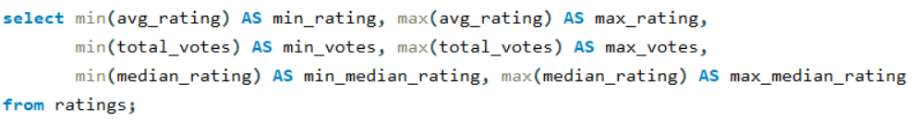

Find the minimum and maximum values in each column of the
ratings table except the movie_id column
Syntax
Output

Slide 11
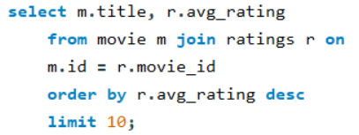
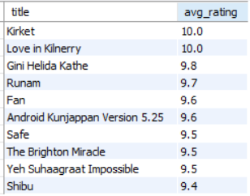
Which are the top 10 movies based on average rating ?
Syntax
Output

Slide 12
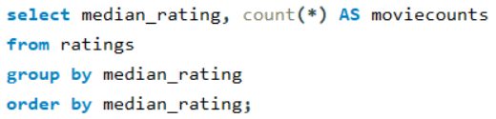
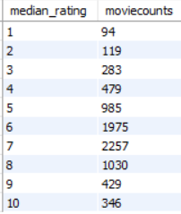
Summarise the ratings table based on the movie counts by median ratings
Syntax
Output
Meadian Rating
7 - 2257

Slide 13
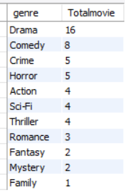
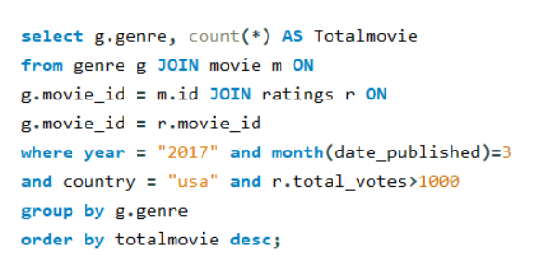
How many movies released in each genre during March 2017
in the USA had more than 1,000 votes
Output
Syntax
Drama > Comedy > Crime > Horror

Slide 14
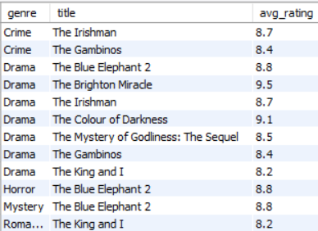
Find movies of each genre that start with the word ‘The’
and which have an average rating > 8
Syntax
Output

Slide 15
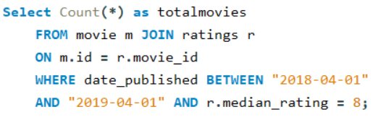

Of the movies released between 1 April 2018 and 1 April 2019,
how many were given a median rating of 8
Syntax
Output

Slide 16
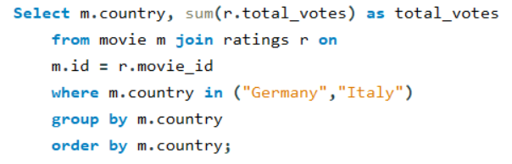

Do German movies get more votes than Italian movies?
Syntax
Output
28,745 Votes Than Italy

Slide 17
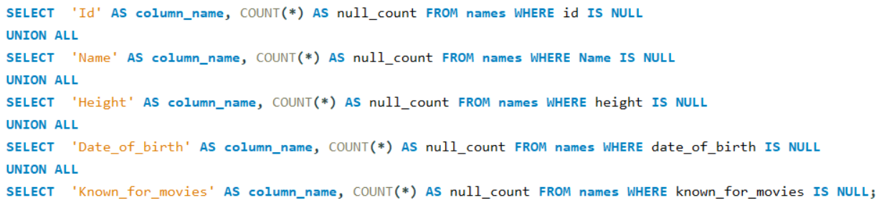
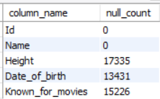
Which columns in the names table have null values
Syntax
Output

Slide 18
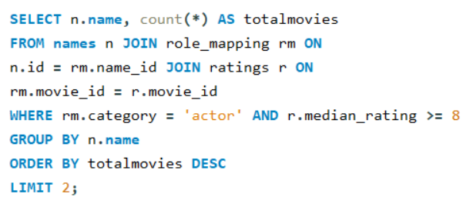

Who are the top two actors whose movies have a median rating >= 8?
Syntax
Output

Slide 19
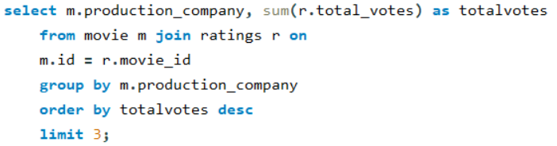

Which are the top three production houses
based on the number of votes received by their movies?
Syntax
Output

Slide 20
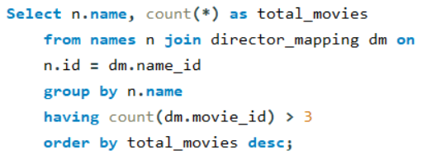
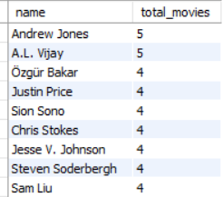
How many directors worked on more than three movies ?
Syntax
Output

Slide 21
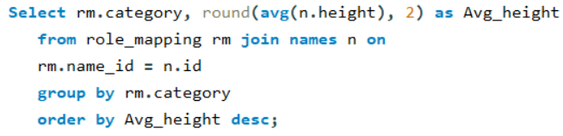

Find the average height of actors and actresses separately
Syntax
Output

Slide 22
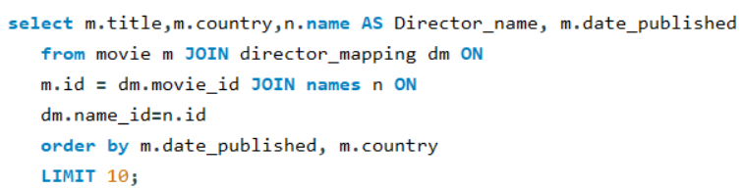
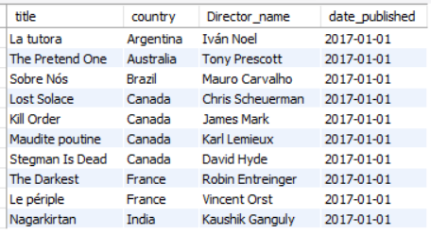
Identify the 10 oldest movies in the dataset along with its
title, country, and director
Syntax
Output

Slide 23
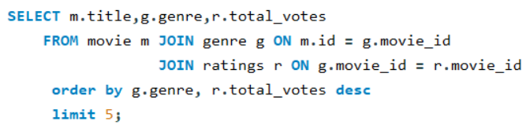
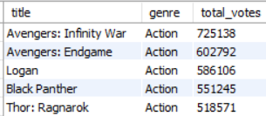
List the top 5 movies with the highest total votes and their genres
Syntax
Output

Slide 24
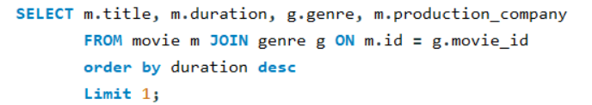

Find the movie with the longest duration, along with its genre and production company
Syntax
Output

Slide 25
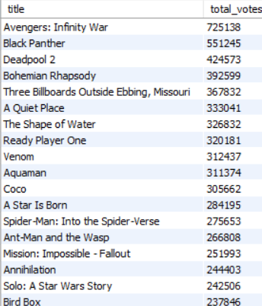
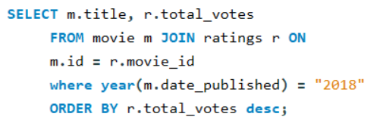
Determine the total votes received for each movie released in 2018.
Syntax
Output

Slide 26
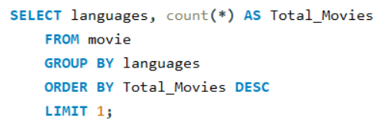

Find the most common language in which movies were produced
Syntax
Output

Slide 27
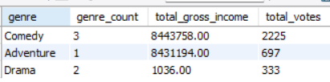

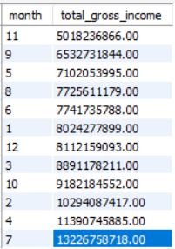
Insights
COUNTRY - PERU, USA
Less Gross Income in Genre “Drama”
Top 3 Directors
With Less Gross Income
Focus On Genre : Adventure, Action
Top Month’s in Gross Income

Slide 28
Thank You Folks...

